Slide 1
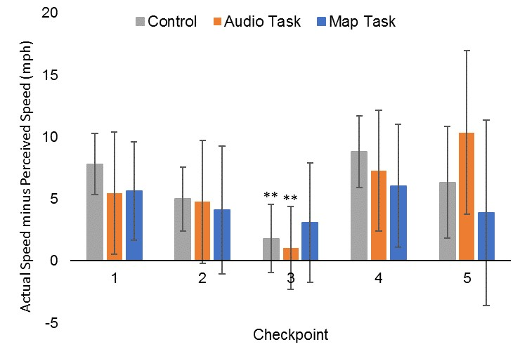
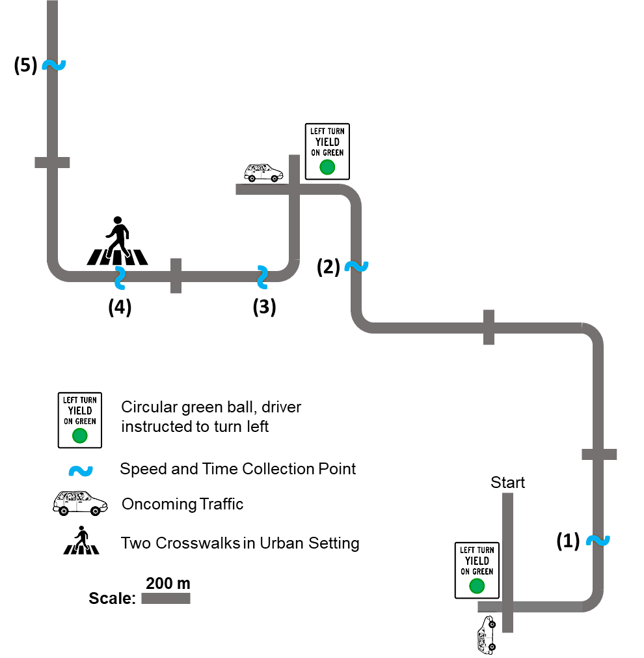
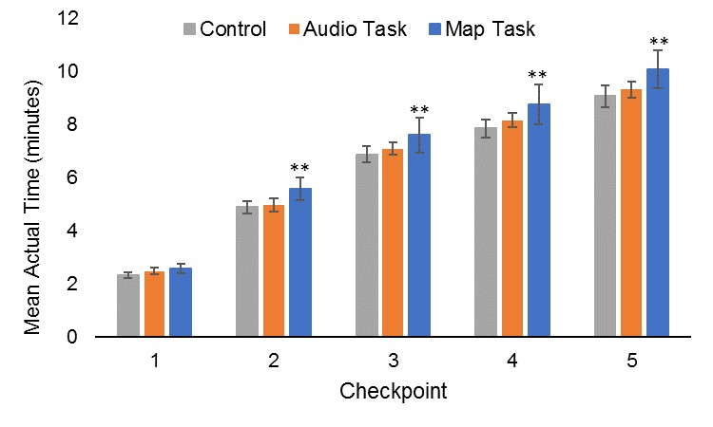
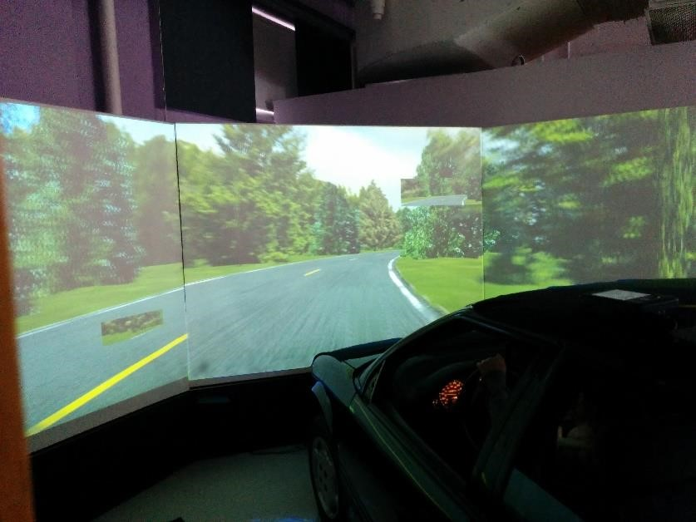
Investigation Of Time And Speed Perception
Using A Driving Simulator
Andronikos Keklikoglou (Research Assistant), Dr. Cole Fitzpatrick (Research Assistant Professor) Dr. Michael Knodler (Associate Professor)
Introduction
Speed & Time Perception
Crashes
Thirty-four drivers participated in a driving simulator experiment which investigated time and speed perception as it related to cognitive workload resulting from secondary tasks. Each participant drove the virtual drive twice, once with either an audio or a map task and again with no distractions as a control. Participants knew from a practice drive that they would be asked to estimate their speed and time duration of driving, thus this study used the prospective paradigm.
When combining all groups and all checkpoints, subjects perceived their speed 5.6 mph lower than their actual speeds
Subjects with the map task took 68 seconds longer to reach the fifth checkpoint than subjects in the control drive, a statistically significant result (p = 0.013).
Nine out of the 34 drivers crashed the virtual vehicle, ending the drive and resulting in a partial dataset. Six subjects crashed in the second drive, two crashed during the first drive, and one crashed in both the first and second drive. All of these crashes occurred on a right horizontal curve, which was used in a study examining roadside vegetation and clear zone size.
Methodology
The driving simulator in the Arbella Insurance Human Performance Laboratory at UMass Amherst was used. 34 drivers were recruited to participate in the study, where each driver completed two drives:
The one drive had no distraction
The other drive had a distraction, either visual or audio distraction.
At five fixed points the drivers were questioned to estimate:
The speed at this point of the drive
The time elapsed since the start of the drive
Drive Types
Audio Distraction Task: Participants were asked to verbally respond to a sentence, played through the speakers
Visual Distraction Task: Participants were asked through the speakers, to locate a street on a map while driving.
Control: In this task, participants were only asked to perceive the time intervals since the start of the drive and the speed at each checkpoint with no distractions.
Mean differences between actual and perceived speeds for the three drive types
Mean differences in perceived and actual times during the first drive for drivers who crashed in the second drive versus drivers who did not crash
Group: Drive 1 / Drive 2 | Male Total (Complete) | Female Total (Complete) | Driver Age in yr Mean ± Std. Dev. | Driving Experience in yr Mean ± Std. Dev.
Control/Map | 4 (3) | 3 (3) | 25.3 ± 4.3 | 9.0 ± 4.4
Map/Control | 5 (3) | 4 (3) | 21.2 ± 3.2 | 3.1 ± 1.9
Control/Audio | 4 (4) | 3 (2) | 26.9 ± 5.5 | 8.7 ± 7.3
Audio/Control | 6 (3) | 5 (3) | 27.2 ± 10.7 | 9.2 ± 7.9
The last speed recorded of drivers who crashed compared to speeds of the non-crashing drivers is much higher and it makes clear that these crashes occurred due to excessive speeds:
Last speed recorded of crashing drivers (M = 54.8, SD = 11.3)
Speed of non-crashing drivers at this point (M = 41.6, SD = 7.6)
The difference in time perception with drivers who did not crash at all was statistically significant at 90% for checkpoints 3, 4, and 5. This shows that drivers who perceived a longer time interval during the first drive, or were more bored by the drive, were more likely to crash during the second drive.
Schematic of the virtual drive that participants encountered
Mean actual time at each checkpoint for three groups
Conclusions
Limitations & Future Research
Thirty-four drivers participated in a driving simulator experiment which investigated time and speed perception as it related to cognitive workload resulting from secondary tasks.
Based on previous literature it was expected that there would be an underestimation of time and an overestimation of speed.
The reverse occurred, participants overestimated time and underestimate their speed. This suggests that drivers may have found the drive unstimulating, despite the secondary tasks, and that the rural environmental may have impacted speed perception.
Additionally, a large group of participants, nine out of 34, crashed the virtual vehicle at a horizontal curve that was not problematic in previous simulator studies.
It was found that drivers who crashed in the second drive had significantly worse time perception in the first drive as compared to drivers who did not crash in the second drive. This finding suggests that current time perception may be a predictor of future speed selection.
Limitations
The small sample size was a significant limitation to this study.
The high number of crashes due to excessive speeds around corners was unanticipated and severely limited the power of the statistical analyses
Future Research
A future study should be conducted which alters the roadway geometry so that the horizontal curves are more safely navigated at higher speeds.
The overestimation of time in the prospective paradigm was unexpected based on previous literature, a future study could use a more stimulating roadway environment to see if the roadway environment significantly affects the cognitive stimulation and thus influences time perception. A more stimulating environment may also lead to more accurate speed perception, making the distinction worth exploring.
Splitting participants into one secondary task or the other may obfuscate the results due to individual behavior variances. A future study should focus on a single secondary task so that definitive conclusions about how a specific type of distraction influences time and speed perception.
University of Massachusetts Transportation Center
http://www.umasstransportationcenter.org/
Department of Civil & Environmental Engineering
cfitzpat@umass.edu

